Slide 1
CSS
Part III
Sprites!
Presented by Steven King

Slide 2

The Future is from the Past

Slide 3
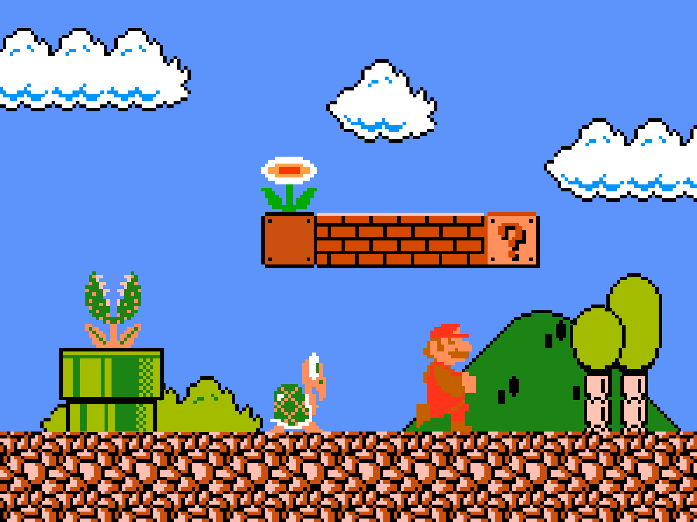
A page of graphics

Slide 4
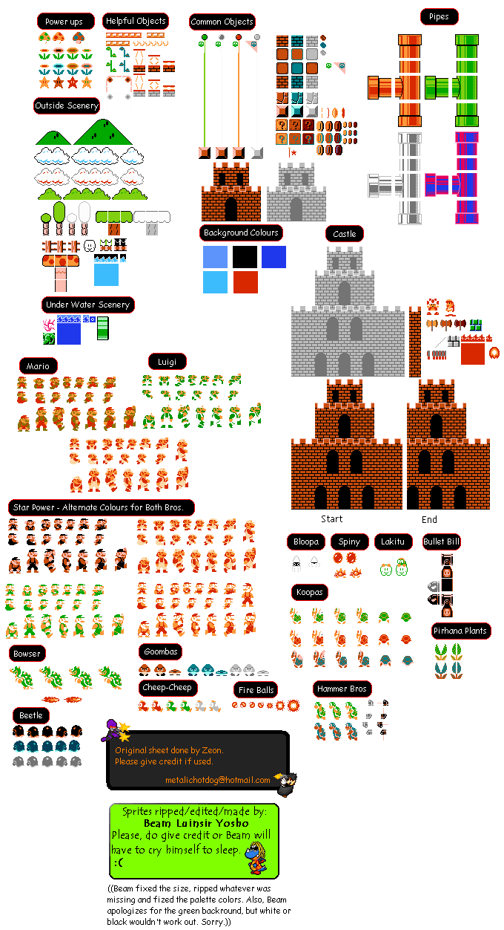
A page of graphics

Slide 5

Background

Slide 6
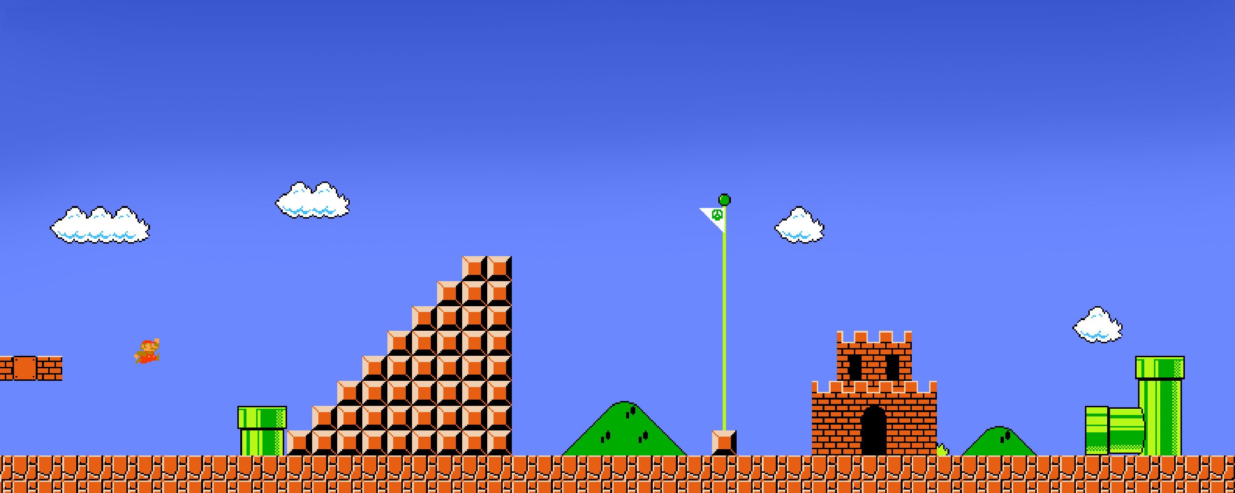

Slide 7

Why Sprites
Reduce number of Requests
Faster loading
Consistent design
Faster and easier to build

Slide 8
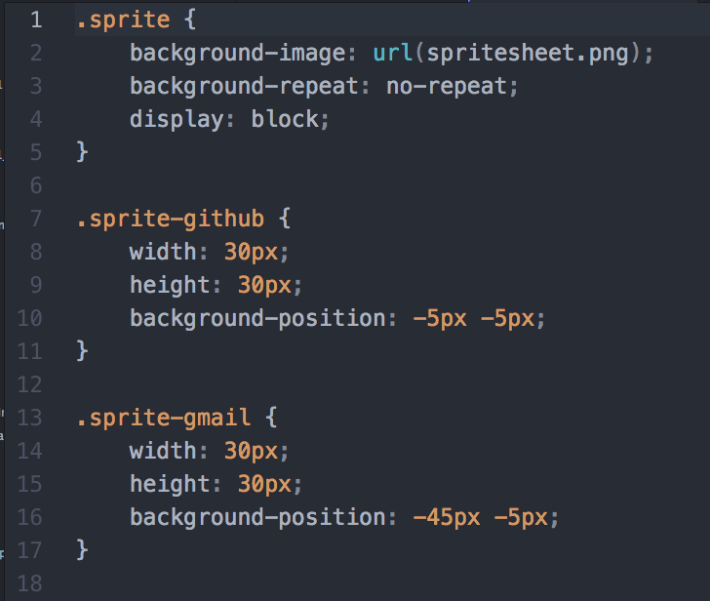
How it works!
Set the X and Y coordinate of the same image
Uses the
background-position property
Shift and change the X and Y instantly.

Slide 9

1. Make an image
Open Design in Photoshop

Slide 10
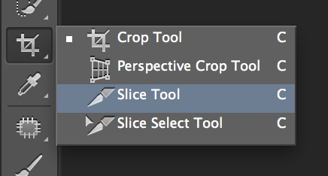
Slice and Dice
Use the Photoshop Slice Tool
Slice Select Tool.
- Name Slice
Export For Web
-Images Only.

Slide 11
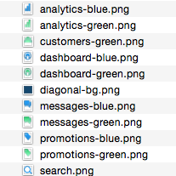
Be
Organized
Keep to a plan!

Slide 12
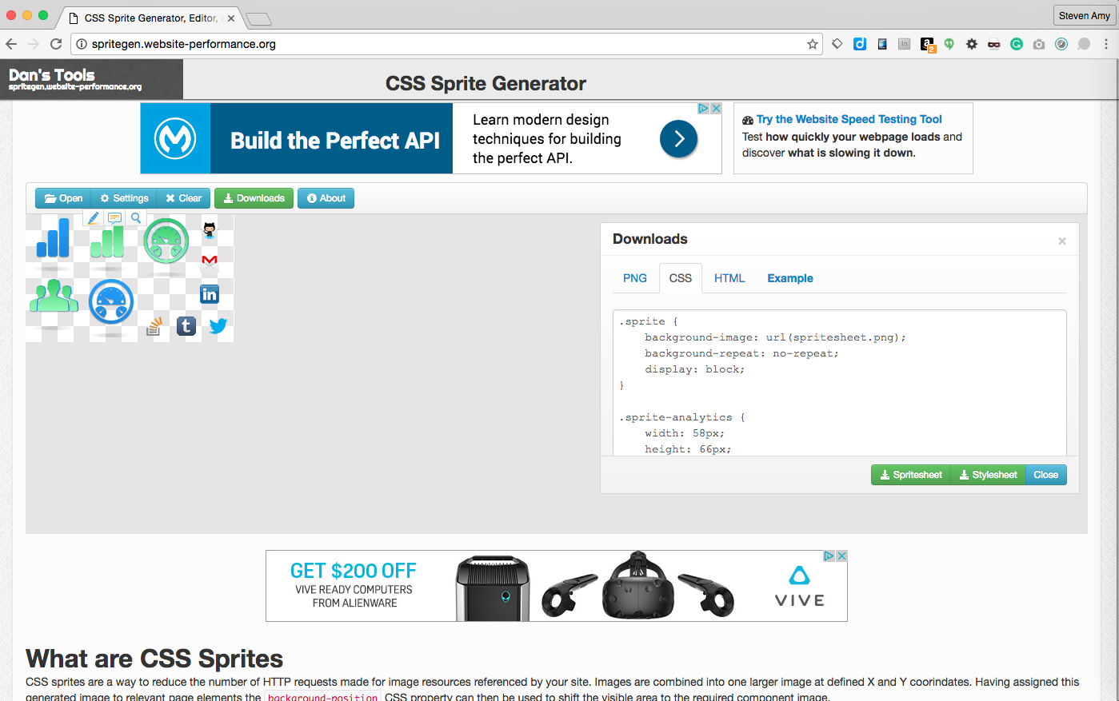
2. Use a cool Tool!
http://spritegen.website-performance.org/

Slide 13
3. Implement Code from Generator
http://spritegen.website-performance.org/

Slide 14
Assignment
Putting into practice

